Slide 1
Temperature Logger
Marton Lorinczi
2017.06.09

Slide 2


Slide 3
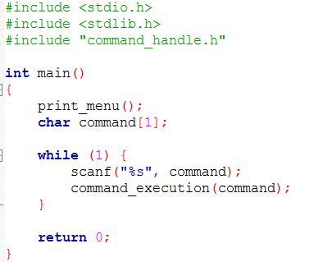
Most complex code you have ever seen !

Slide 4
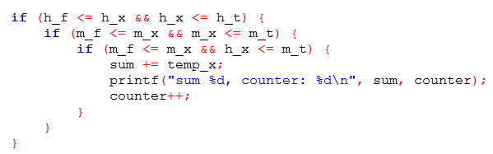
This line was half day of work →
Too much variable for a little work →
How many conditions are here? →

Slide 5
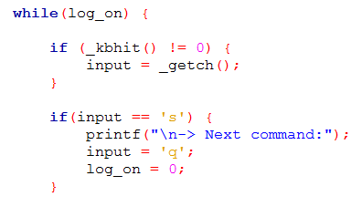

How to intterupt in a while?

Slide 6
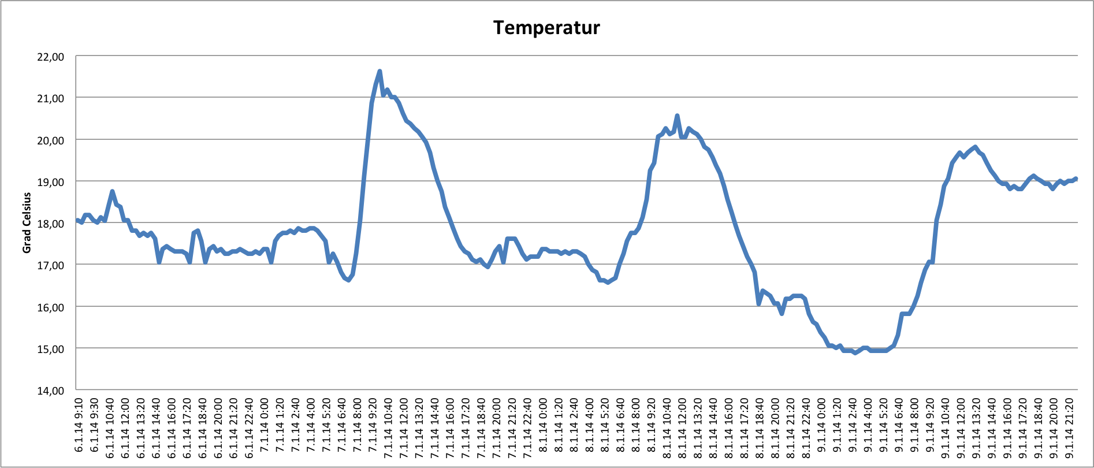
Demonstrate how it works.

